Slide 1
CNCH 2023

Slide 2
August 3-6, 2023
Cal poly
San Luis obispo

Slide 3
CNCH 2023 - learn by doing Registration Timeline
Early Registration:
April 29, 2023 9:00 AM until June 10, 2023, 5:00 PM
Late Registration:
June 10, 2023, 5:01 PM until July 9, 2023, 5:00 PM
All registration closes on Sunday, July 9, at 5:00 PM.
Last day to cancel and get a refund minus $100 fee:
June 20, 2023, 5:00 PM

Slide 4
CNCH 2023 - learn by doing À la Carte Pricing
Conference Registration (includes Workshop; BBQ & Reception):
Early CNCH Member: $475. Early Non-CNCH Member: $505.
Late CNCH Member: $505 Late Non-CNCH Member: $535.
Optional:
Housing (3 nights; Thursday – Saturday): $395.
Meal Plan (meals from Thursday dinner to Sunday lunch): $95.
Extra BBQ & Reception: $50

Slide 5
CNCH 2023 - learn by doing Tentative Schedule of Events
On-Site Check-in: Thursday, 2:00 PM to 8:00 PM; Friday, 7:30 AM to 9:00 AM.
Workshops: Friday & Saturday, 9:00 to noon & 1:30 to 4:30; Sunday, 9:00 to noon (15 hours of instruction).
Friday evening: Barbecue and Guest Speaker
Saturday evening: Reception, “Walk Around” Fashion Show, and Workshop Walkabout
Marketplace Vendor: Eugene Textile Center
Conference closes at noon, Sunday, August 6.

Slide 6
The Cal Poly campus, San Luis Obispo

Slide 7
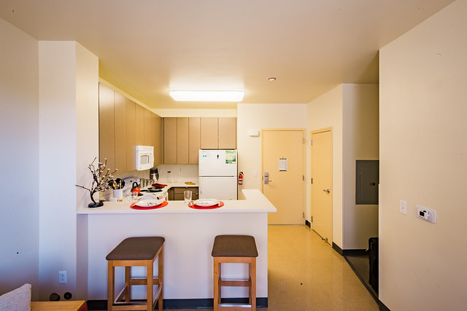
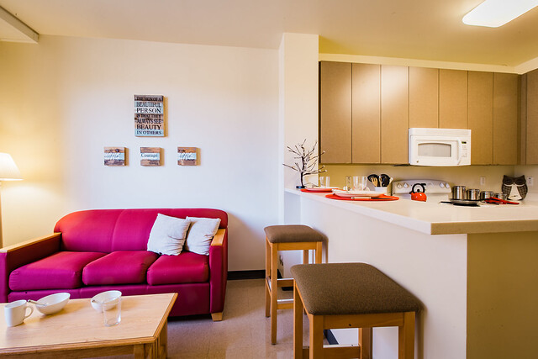
Housing
Apartment-style housing will be available at the Poly Canyon Village.
Each unit has 4 bedrooms, 2 baths, a kitchen and living room.
Virtual Tour of Aliso Dorm

Slide 8
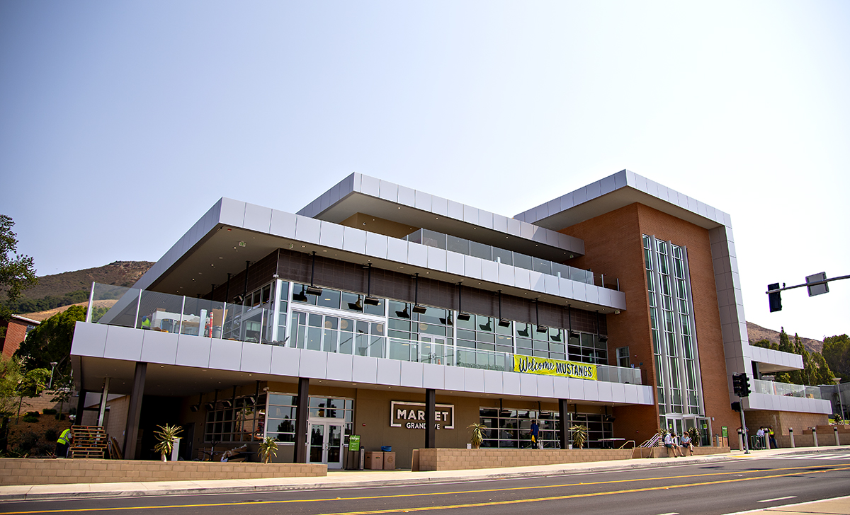
Meals
Optional Meal Plans may be purchased, or purchase ala carte food on campus or elsewhere in the San Luis Obispo area.
Cal Poly Campus Dining Virtual Tour 2022 - YouTube

Slide 9
Weaving Workshops

Slide 10
Inge Dam
Tablet Band Incorporated into Fabric

Slide 11
Tablet Band Incorporated Into Fabric
Make a Unique Fabric For a Small Bag
A tablet warp will be made, and you will learn how to arrange the tablet warp within the fabric warp that has been wound on the loom ahead of time.
You will learn how to accommodate the difference in take-up of the two weaves.
A small piece of fabric will be woven, with ideas on making the bag

Slide 12
Joanne Hall
Swedish Art Weaves

Slide 13
Swedish Art Weaves
The warp is threaded to plain weave so a variety of patterns and techniques can be woven all in one sampler.
These include krabba, halvkrabba, rolakan tapestry, dukagang and monksbelt.
They are a part of both historical and contemporary weaving in Sweden.

Slide 14
Jennifer Moore
Double Rainbow

Slide 15
Double Rainbow
This is perhaps the ultimate color sampler!
As you weave and your warp colors move past each other, you will experience a visual feast of iridescence and moire patterns.
You will get the tools to create your own block designs in doubleweave for as many shafts as you have.

Slide 16
Robyn Spady
A Parallel Threading is a Weaver’s Playground

Slide 17
A Parallel Threading is a Weaver’s Playground
Enter into a journey of discovery and exploration of how to transform a parallel threading into a myriad of patterns.
You’ll learn the design and drafting processes to empower you to create your own patterns.
From echo weaves and corkscrew twills to turned taqueté and network-drafted twills - it’s all here!

Slide 18
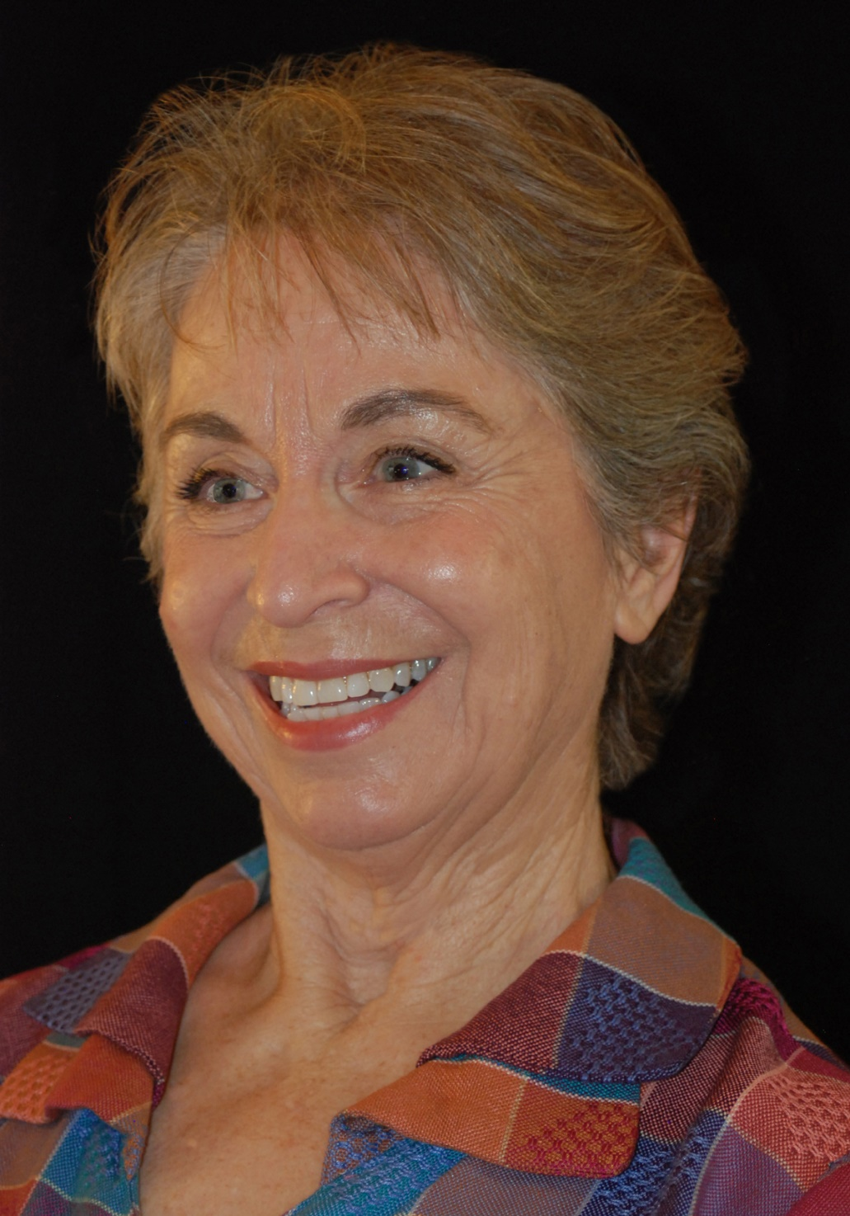
JANNIE TAYLOR
A Survey of Loom Controlled Lace

Slide 19
LOOM CONTROLLED LACE
Learn all about Loom-Controlled Lace through illustrated lecture, guided practice; and hands-on weaving.
Discover the subtle differences between these similar weaves and how to tell them apart.
Weave an assortment of samples on looms threaded to a variety of Lace Weaves.
You’ll create your own annotated Lace Weave workbook and set of samples.

Slide 20
Spinning Workshops

Slide 21
Kate Larson
Vibrant: Blending and Spinning
for Color Effects

Slide 22
Blending and Spinning for Color Effects
You’ll prepare and sample a variety of yarns -- tweed, marled, ombre and more -- while exploring color interactions.
Learn to create several different preparations and blends using your handcards.
Try your hand at color blending on a hackle.

Slide 23
Angela Schneider
The Short and Long of Spinning

Slide 24
The Short and Long of Spinning
Explore drafting techniques and fiber preparations that cover the range from the smoothest worsted to the loftiest woolen yarns.
Plus try the carding and combing techniques to go with them.
Examine the appropriate fibers, preparations, and characteristics for each.

Slide 25
Dyeing Workshops

Slide 26
Nancy Finn
Working Your Way Around the
Color Wheel: A Color Survey

Slide 27
Working Your Way Around the Color Wheel: A Color Survey
Create your own set of colors including primary, secondary, and tertiary colors.
This also includes toned and shaded colors, as well as tints and a gray scale.
Each student will create approximately 100 color samples, time and energy permitting.

Slide 28
Graham Keegan
Know Madder:
Many Roads, Many Reds

Slide 29
Know Madder: Many Roads, Many Reds
Red! Maroon! Plum! Peach! Flame Orange! Pink! Madder’s allure is its versatility, potency and longevity.
Explore the processes that allow the transfer of color from the roots of this hearty perennial onto a range of fibers.
You’ll get a deeper understanding of the plant, how to grow and process it, how to harvest and store it and, of course, how to dye with it.

Slide 30
Teresa Ruch
Designing and Painting Warps

Slide 31
Designing and Painting Warps
Various ways to design painted warps to give yours a unique look.
You’ll dye a 2-scarf warp in a random fluid manner where one color flows into the next, creating shades, tints and tones and the feather look one gets with most ikats.
Different layout and design techniques for painted warps: how to plan, dye, and carry through for the effect you want.

Slide 32
Basketmaking workshops

Slide 33
Deb Curtis
Birch Bark Exploration

Slide 34
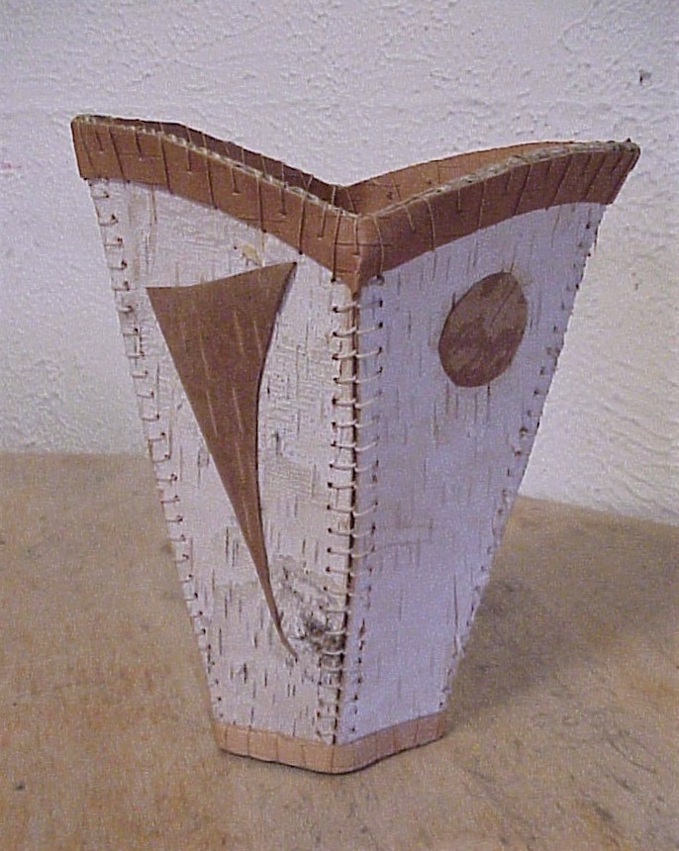
Birch Bark Exploration
From cylinders to stitched pieces of bark, you’ll explore how birch bark can be made into vessels.
You’ll start by making a stitched cylinder, then design a vessel.
You are given ideas/designs or you can design your own vessels.

Slide 35
Polly Giacchina
The Enhanced Twined Form

Slide 36
The Enhanced Twined Form
Discover other fiber techniques to embellish your initial twined form.
Using multiple soft and hard materials, develop the surface of your work.
You’ll use these techniques: twining, knotless netting, random weave, stitching and applique.

Slide 37
FELTING

Slide 38
Flora Carlile-Kovacs
Felt Your Dreams:
Prefelt with Nomadic Designs

Slide 39
Felt Your Dreams: Prefelt with Nomadic Designs
You’ll create two complementary pillow pads with the pre-felt technique, using either the several-hundred-year-old symbols or by creating your own.
Learn about the traditional symbols and techniques of the rugs; how to plan a powerful design; how to turn the soft prefelt into a strong and durable pillow pad; some tricks of the trade.

Slide 40
Kumihimo

Slide 41
Shirley Berlin
Japanese Braiding:
Make Friends with a Marudai

Slide 42
Japanese Braiding: Make Friends with a Marudai
Capture the magic of working not on a disc but on real equipment.
Using both hands to braid on a marudai, the new braider can quickly enjoy - and be bewitched by - the rhythm of the traditional Japanese movements.
The sound of many wooden bobbins moving in harmony is a memory for life!

Slide 43
Sprang

Slide 44
Carol James
Introduction to Sprang

Slide 45
Introduction to Sprang
Sprang is a textile technique that dates to ancient times.
Learn the basic stitch, and then see how it can be adapted and shaped.
You can use it to create bags, bonnets, socks, mittens, scarves, leggings, vests, and more.

Slide 46
Tapestry

Slide 47
Kathe Todd-Hooker
Line & Detail and the
Geometry of Tapestry

Slide 48
Line and Detail and the Geometry of Tapestry
All about controlling lines, shapes, vertically, horizontally, diagonally and curves.
Techniques used and explored: Soumack, splitting the weft, perfect shapes, toothless, smooth and step-less edges, and no squishing.
You’ll gain an understanding of the techniques that help you achieve the designs and shapes you really want.

Slide 49
And there’s More …

Slide 50
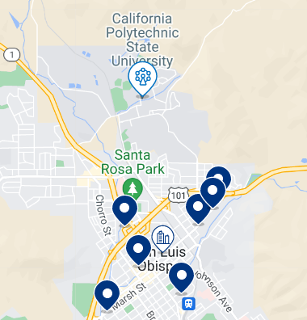
What if you travel with family, or want to stay a few extra days?
There are 11 hotels/motels within five minutes of the Cal Poly campus.
They are located along Monterey Street near the 101 and Grand Avenue exit
Directly accessible to the campus via Grand Avenue
15 minutes to the coast
Hotels include:
La Cuesta
La Quinta
University Inn
Buena Vista
Pear Tree
Wayfarer
Apple Farm

Slide 51
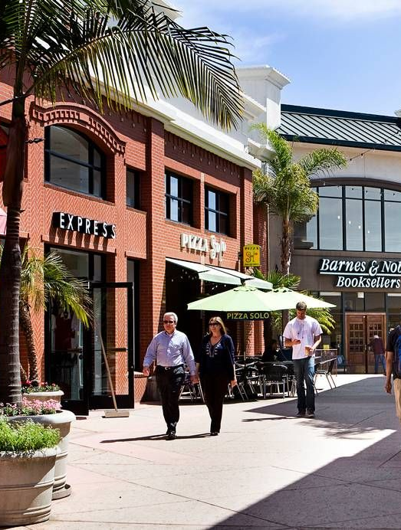
Shopping & Dining
Many options in Downtown San Luis Obispo
Morro Bay Embarcadero
Avila Beach
Pismo Beach
Cambria

Slide 52
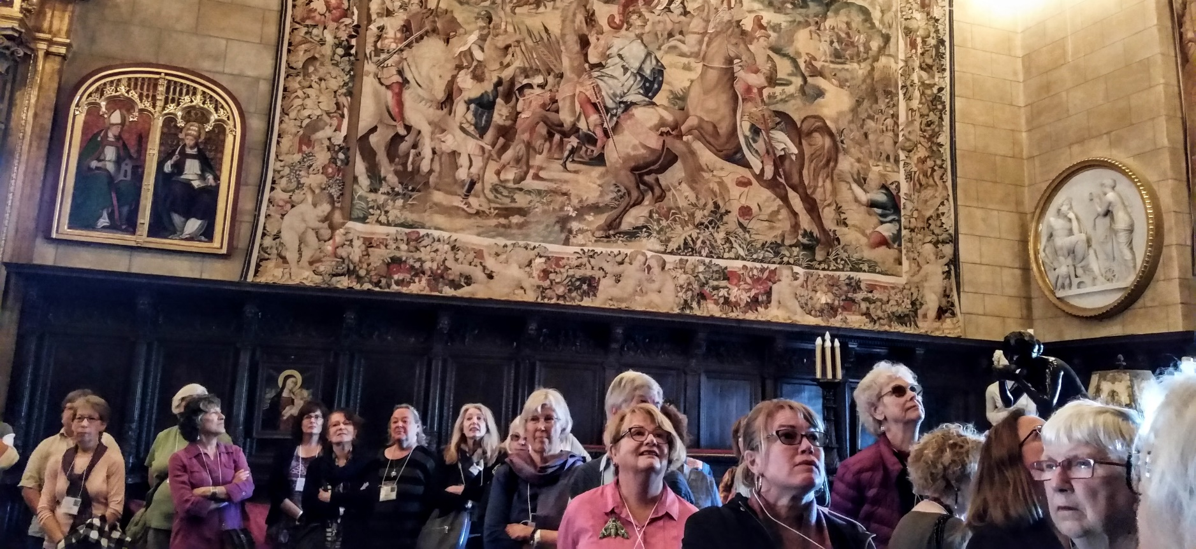
Hearst Castle
45 minutes from Cal Poly
Spectacular art, antiques and swimming pools
Outstanding collection of 16th and 17th Century tapestries

Slide 53
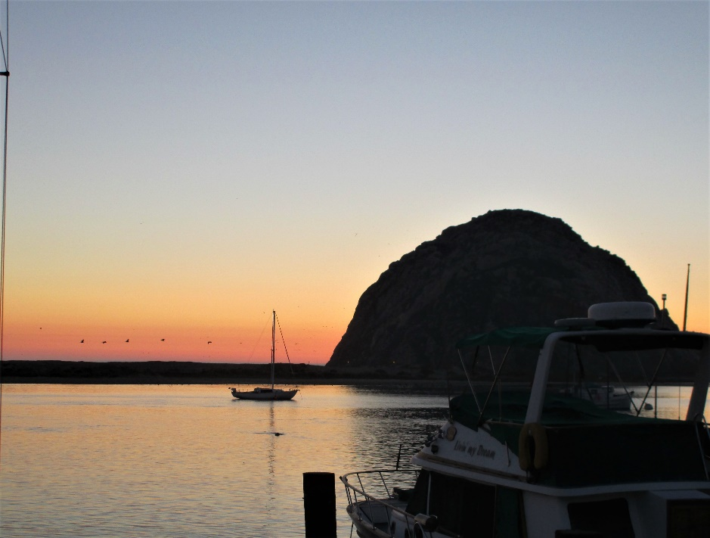
Gorgeous Beaches
Morro Bay, Pismo Beach, Avila Beach
Beach walking, kayaking or just dining at sunset

Slide 54
200 Wineries
Edna Valley – Lighter Chardonnays and Pinot Noirs
North County – Full bodied Cabernets, Zinfandels and Syrahs

Slide 55
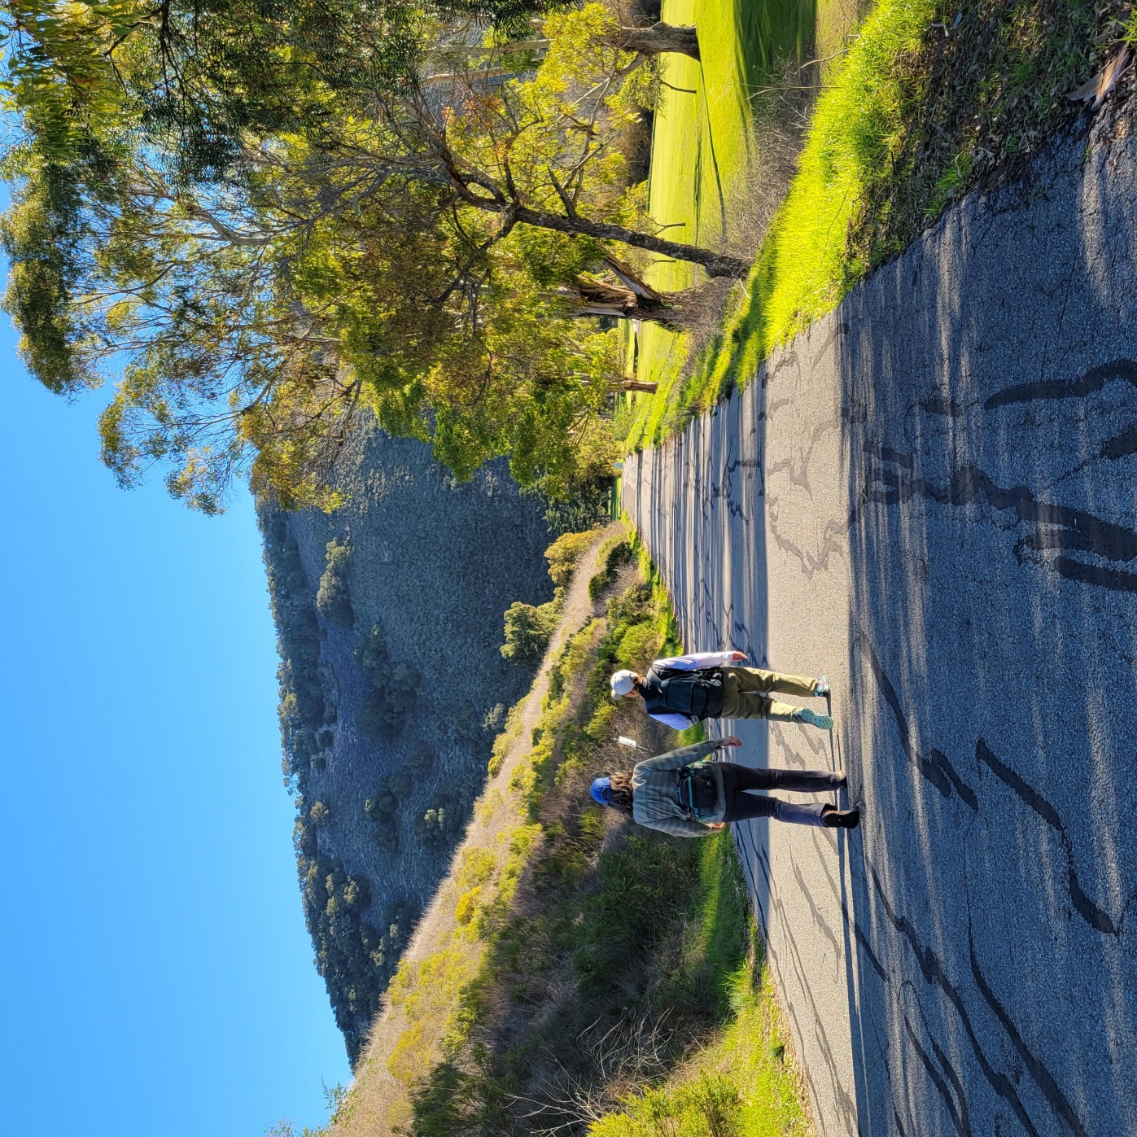
Many Hiking Trails
Whether you want flat, paved and easy trails
Or steep, rocky and challenging climbs
SLO County is a hiker’s dream!

Slide 56
We’re depending on you to spread the word about the great teachers, fabulous workshops, attractive accommodations and spectacular location. The registration booklet is available on the cnch web site to view and/or download as of this morning.

Slide 57
See you in San Luis Obispo in August, It’s going to be amazing!

